Slide 1
A Simple Algorithm for the Constrained Sequence Problems
Francis Y.L. Chin, Alfredo De Santis, Anna Lisa Ferrara, N.L. Ho and S.K. Kim
Information Processing Letters, Vol. 90, No. 4, pp. 175-179, Jan. 2004
Date : Oct. 15, 2004
Created by : Chia-Chang Wang

Slide 2
Abstract
In this paper we address the constrained longest subsequence problem.Given two sequence X, Y and a constrained sequence Z is a constrained longest common subsequence for X and Y with respect to P if Z is the longest subsequence of X and Y such that P is a subsequence of Z.Recently, Tsai proposed an O(n² m² r) time algorithm to solve this problem using dynamic programming technique, where n, m and r are the lengths of X, Y and P, respectively.

Slide 3
Abstract(cont.)
In this paper, we present a simple algorithm to solve the constrained longest common subsequence problem in O(nmr) time and show that the constrained longest common subsequence problem is equivalent to a special case of the constrained multiple sequence alignment problem which can also be solved with the same complexity.

Slide 4
What is the Constrained LCS Problem?
The constrained LCS of abcde and acdbe is abe when constraint sequence is b
acde is NOT
The constrained LCS of cattagc and tcaggatca are cata and catc when constraint sequence is cat
tagc is NOT

Slide 5
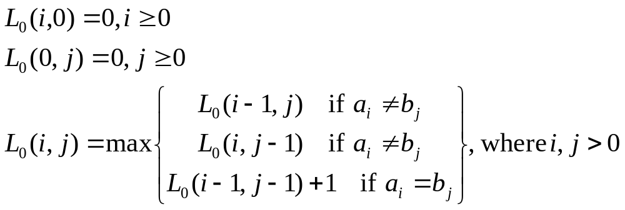
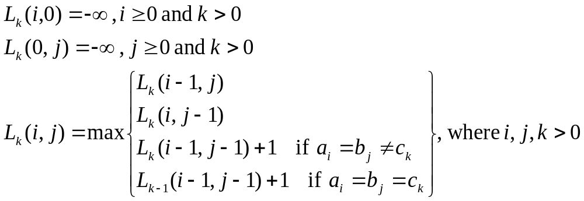
Algorithm

Slide 6
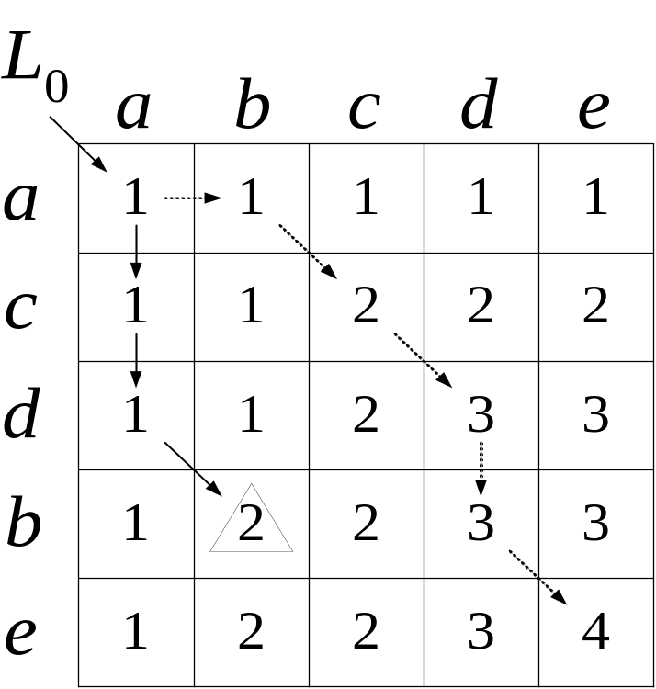
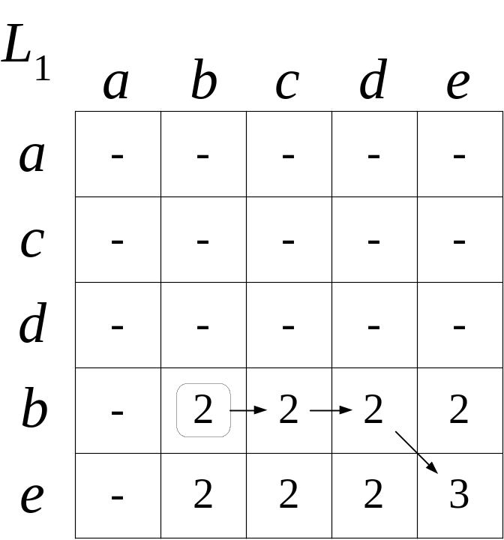
Simple Example
Sequence A: abcde B: acdbe
Constraint sequence: b

Slide 7
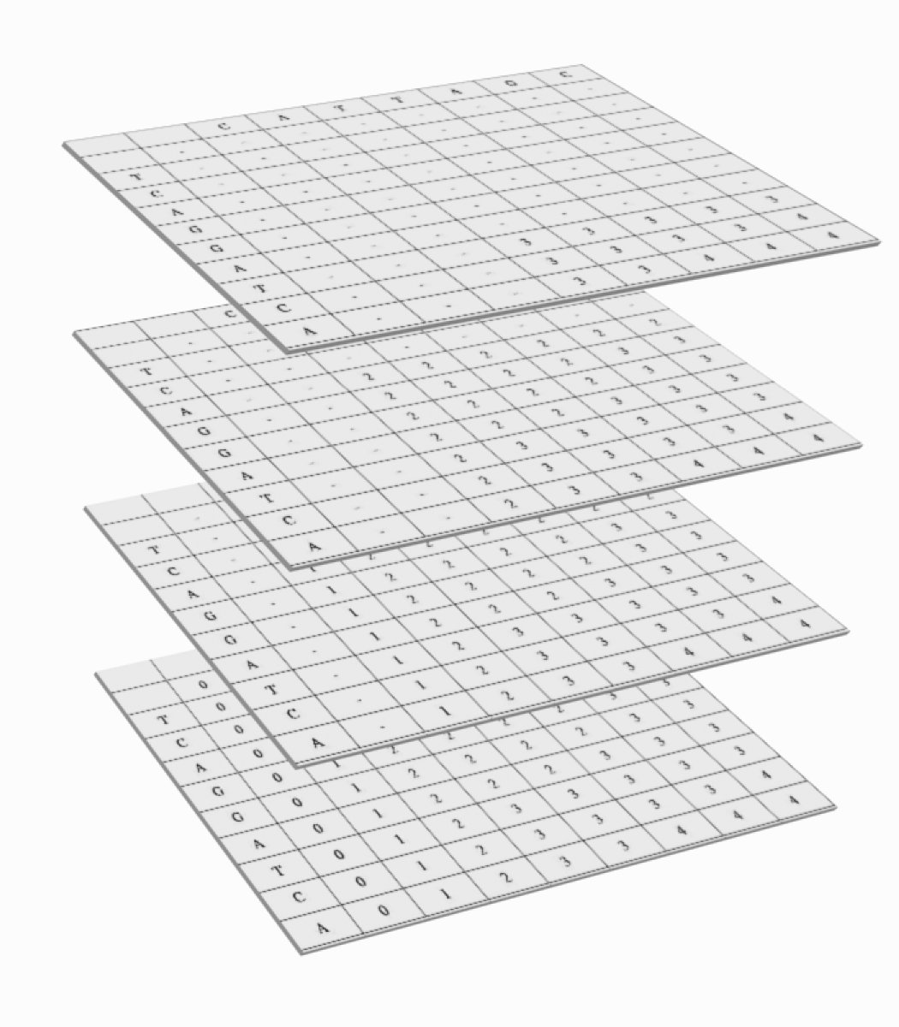
Algorithm(cont.)

Slide 8
Example
Sequence A: cattagc
Sequence B: tcaggatca
Constraint sequence: cat
The constrained longest common subsequence are cata and catc

Slide 9
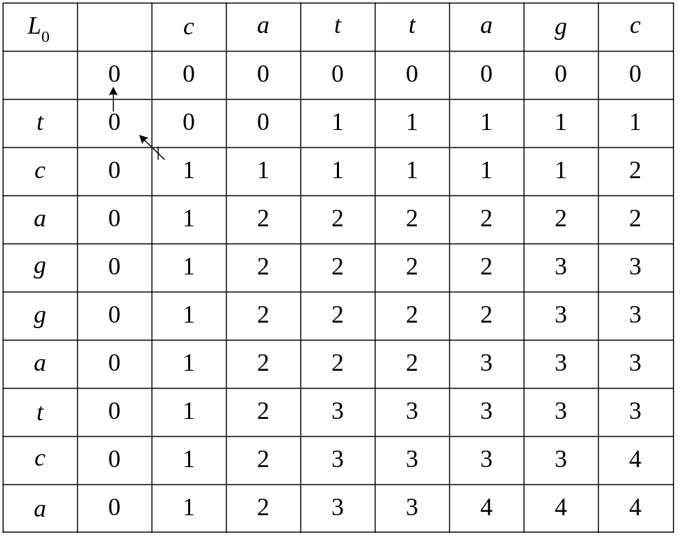
Matrices L₀

Slide 10
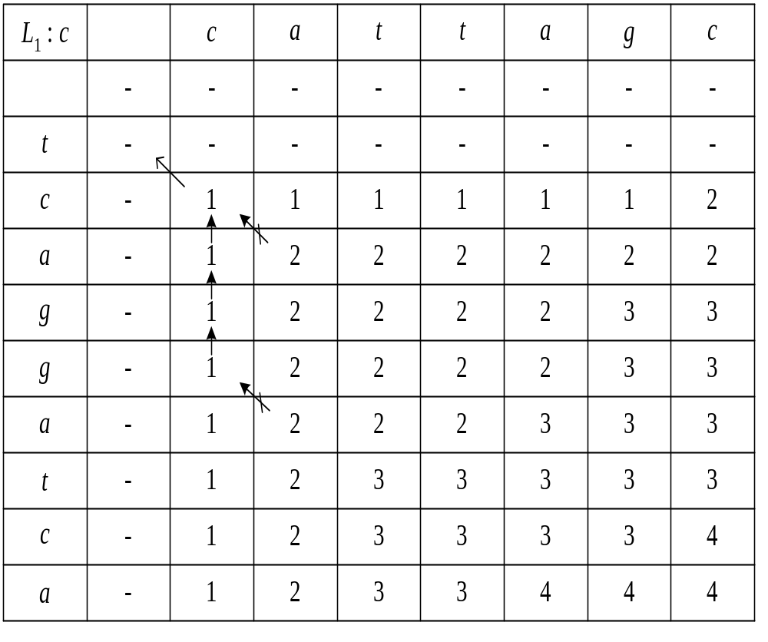
Matrices L₁

Slide 11
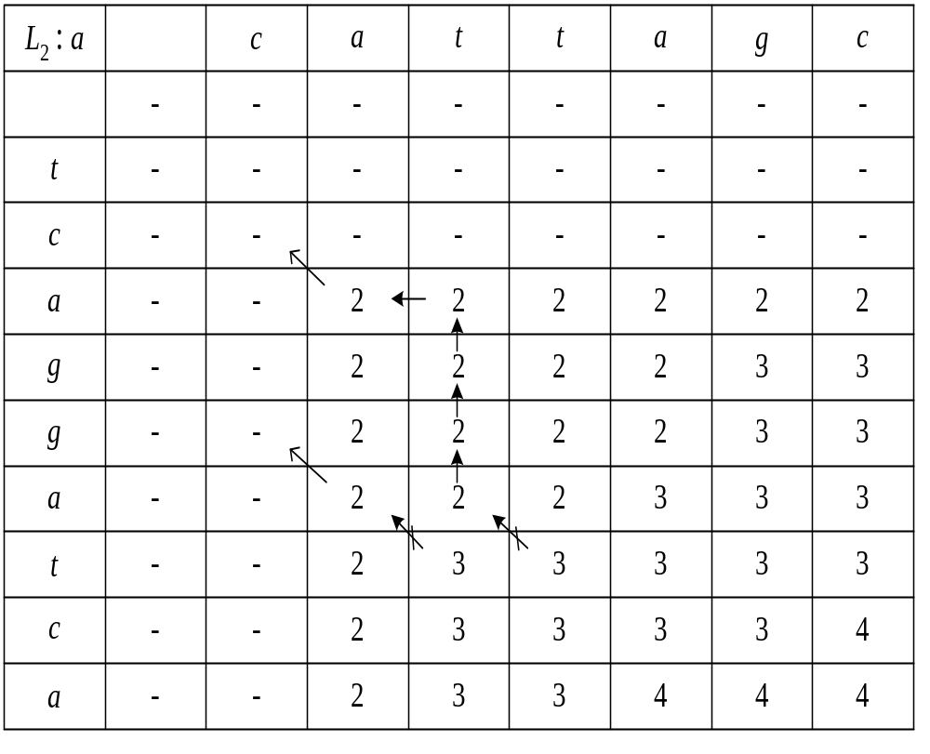
Matrices L₂

Slide 12
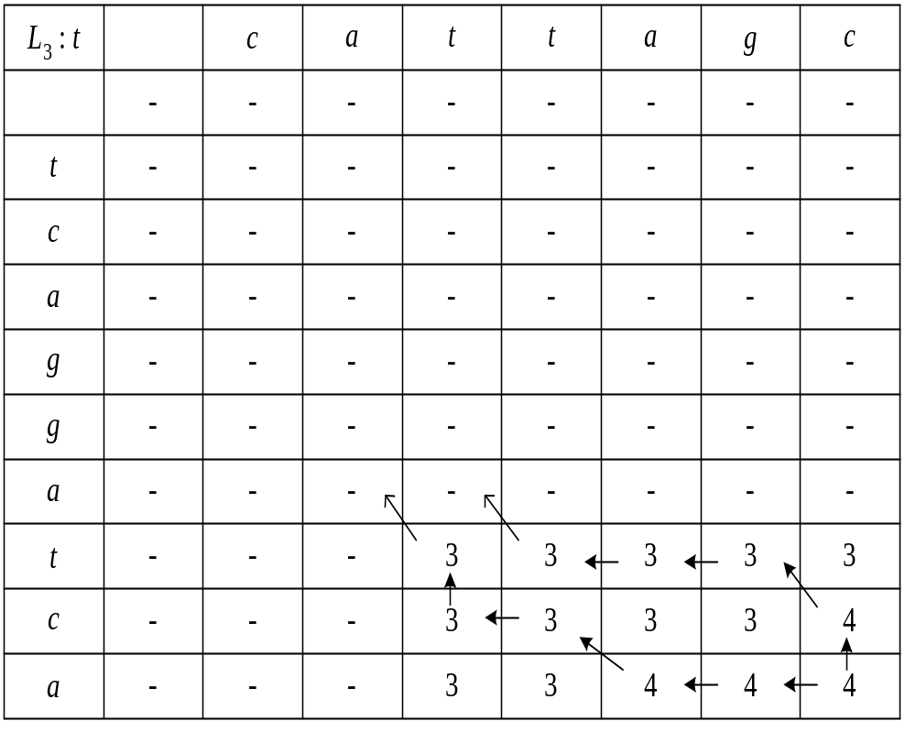
Matrices L₃

Slide 13
Conclusion
The time and space complexity of the constrained LCS algorithm is O(mnp), m and n are the lengths of the original sequences and p is the length of the constraint sequence.

